Slide 1
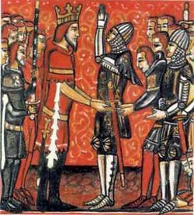
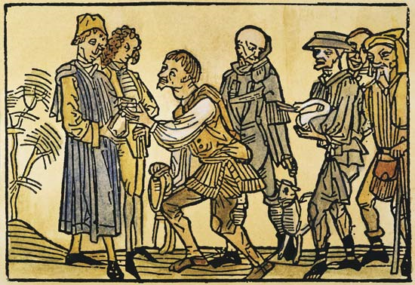
Feudalism in Europe

Slide 2
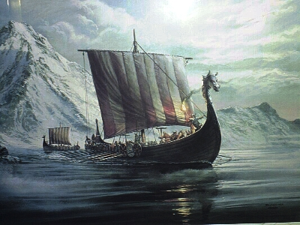
Feudalism Develops Because:
Rome collapses and suddenly people are on their own – who will protect them??
Very unstable world: Germanic tribes invading, Vikings start attacking.
Solution: people seek out powerful lords who could protect them…for a price

Slide 3

Solution: Feudalism!
Feudalism: system where rich, powerful lords offer protection to people in return for service
  Lords run their own estates with their own rules
  People pay taxes to the lords for protection
  Lords are responsible for protecting people from invaders

Slide 4
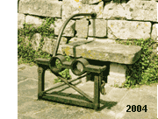
What is Feudalism?
Feudalism is a form of government ran by individual lords who:
Managed their own estates
Enforced their own laws
Made their own money
Collected taxes and tolls
Demanded military service from vassals (knights, peasants, serfs).
Feudalism was built on a relationship of obligation and mutual service between vassals and lords.
Stocks

Slide 5
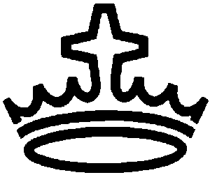
Social Hierarchy of the Middle Ages
King/Clergy
Lords (Dukes, Counts, Barons, etc)
Knights
Professionals (doctors, etc) & Merchants
Serfs/Peasants
Rulers/Nobility
Obligations of military service and custom
Hierarchy
Obligations of land and labor

Slide 6
Kings/Clergy
Kings often figureheads – not much real power
Clergy = Church
  Roman Catholic Church typically has more power than the kings! (WHY??)
    More organized
    Been around longer
    People have more faith in the Church than their rulers

Slide 7
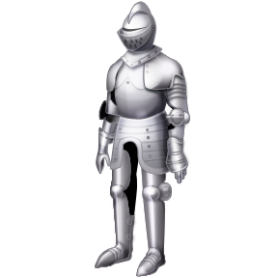
Lords & Knights
Lords more powerful than kings (usually) WHY?
  Gave land to his vassals (knights)
  In return, knights had to serve the lord – money, or battle service

Slide 8
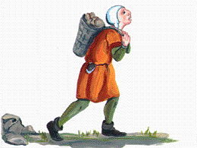
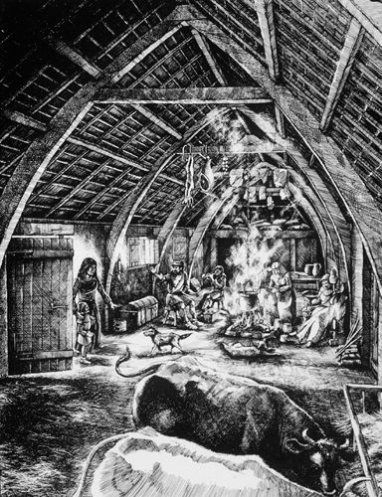
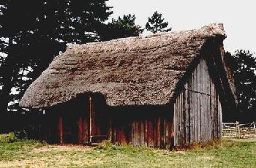
Serfs/Peasants
Majority of people in the Middle Ages
Few rights – bound to lord for life!
  Needed permission to marry, travel, etc
  Simple housing with small farming space
  Worked first for lord (for their protection), then for themselves

Slide 9
Key to Feudalism
Built on relationship of service and obligation between lords, vassals, and peasants
  Everyone has a place in society, and must uphold their place
  Result: many small kingdoms versus one large empire
Thinking questions:
  When does this work well?
  What problems does it create?

